Slide 1
JAVA BOOTCAMP DAY 07
Presented by
G2Academy

Slide 2
Collections/Data Structures in Java
Notes:
How presentation will benefit audience: Adult learners are more interested in a subject if they know how or why it is important to them.
Presenter’s level of expertise in the subject: Briefly state your credentials in this area, or explain why participants should listen to you.

Slide 3
Collections
Collections in java is a framework that provides an architecture to store and manipulate the group of objects.
All the operations that you perform on a data such as searching, sorting, insertion, manipulation, deletion etc. can be performed by Java Collections.
Java Collection simply means a single unit of objects. Java Collection framework provides many interfaces (Set, List, Queue, Deque etc.) and classes (ArrayList, Vector, LinkedList, PriorityQueue, HashSet, LinkedHashSet, TreeSet etc).
Notes:
Lesson descriptions should be brief.

Slide 4
Collections
What is Collection in java? Collection represents a single unit of objects i.e. a group.
What is framework in java?
provides readymade architecture.
represents set of classes and interface.
is optional.
What is Collection framework? Collection framework represents a unified architecture for storing and manipulating group of objects. It has:
Interfaces and its implementations i.e. classes
Algorithm
Notes:
Lesson descriptions should be brief.

Slide 5
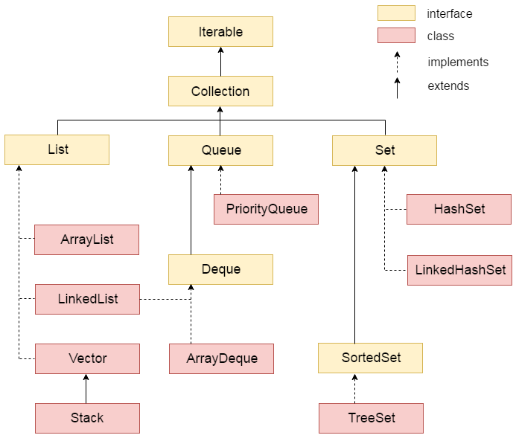
Hierarchy of Collection Framework
Let us see the hierarchy of collection framework. The java.util package contains all the classes and interfaces for Collection framework.
Notes:
Lesson descriptions should be brief.

Slide 6
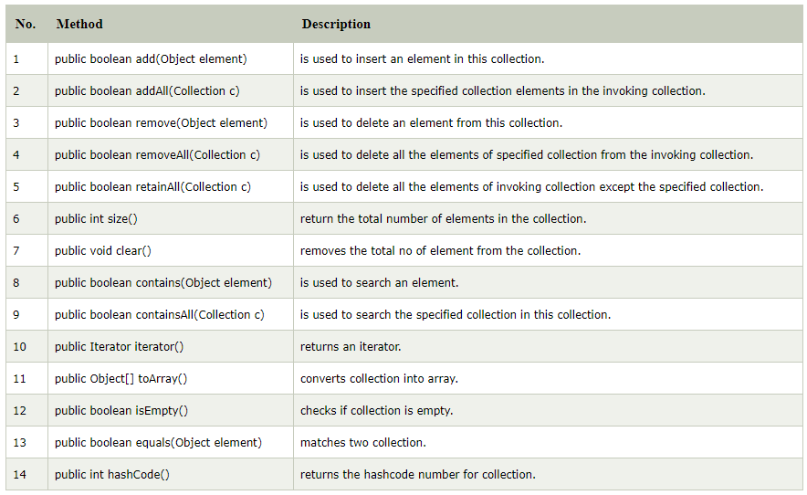
Methods of Collection interface
Notes:
Lesson descriptions should be brief.

Slide 7
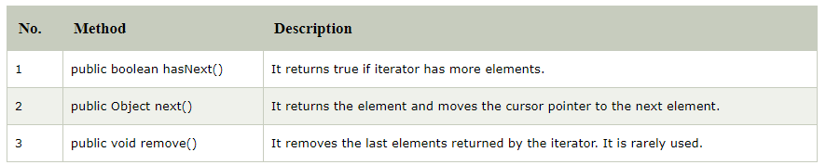
Iterator interface
Iterator interface provides the facility of iterating the elements in forward direction only.
There are only three methods in the Iterator interface. They are:
Notes:
Lesson descriptions should be brief.

Slide 8
Iterator interface
Iterator interface provides the facility of iterating the elements in forward direction only.
There are only three methods in the Iterator interface. They are:
Notes:
Lesson descriptions should be brief.

Slide 9
Java ArrayList
Java ArrayList class uses a dynamic array for storing the elements. It inherits AbstractList class and implements List interface.
The important points about Java ArrayList class are:
Java ArrayList class can contain duplicate elements.
Java ArrayList class maintains insertion order.
Java ArrayList class is non synchronized.
Java ArrayList allows random access because array works at the index basis.
In Java ArrayList class, manipulation is slow because a lot of shifting needs to be occurred if any element is removed from the array list.
Notes:
Lesson descriptions should be brief.

Slide 10
Java ArrayList
Hierarchy of ArrayList class, Java ArrayList class extends AbstractList class which implements List interface.
The List interface extends Collection and Iterable interfaces in hierarchical order.
Let's see the declaration for java.util.ArrayList class.
public class ArrayList<E> extends AbstractList<E> implements List<E>, RandomAccess, Cloneable, Serializable
Notes:
Lesson descriptions should be brief.

Slide 11
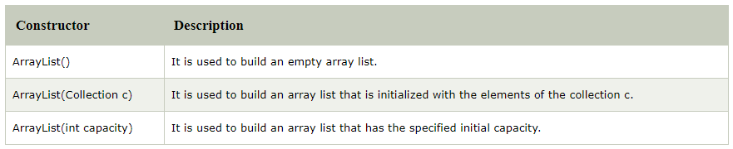
Java ArrayList
Constructors of Java ArrayList
Notes:
Lesson descriptions should be brief.

Slide 12
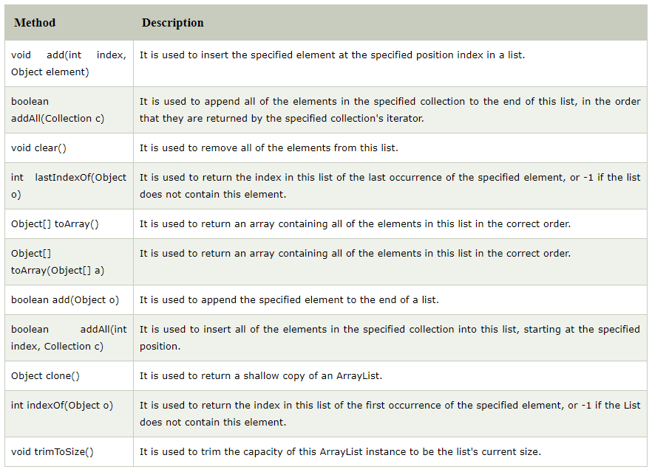
Java ArrayList
Methods of Java ArrayList
Notes:
Lesson descriptions should be brief.

Slide 13
Java ArrayList Example
import java.util.*;
class TestCollection1{
public static void main(String args[]){
ArrayList<String> list=new ArrayList<String>();//Creating arraylist
list.add("Ravi");//Adding object in arraylist
list.add("Vijay");
list.add("Ravi");
list.add("Ajay");
//Traversing list through Iterator
Iterator itr=list.iterator();
while(itr.hasNext()){
System.out.println(itr.next());
}
}
}
Notes:
Lesson descriptions should be brief.

Slide 14
Two ways to iterate the elements of collection in java
There are two ways to traverse collection elements:
By Iterator interface.
By for-each loop.
In the above example, we have seen traversing ArrayList by Iterator. Let's see the example to traverse ArrayList elements using for-each loop
Notes:
Lesson descriptions should be brief.

Slide 15
Iterating Collection through for-each loop
import java.util.*;
class TestCollection2{
public static void main(String args[]){
ArrayList<String> al=new ArrayList<String>();
al.add("Ravi");
al.add("Vijay");
al.add("Ravi");
al.add("Ajay");
for(String obj:al)
System.out.println(obj);
}
}
Notes:
Lesson descriptions should be brief.

Slide 16
User-defined class objects in Java ArrayList
class Student{
int rollno;
String name;
int age;
Student(int rollno,String name,int age){
this.rollno=rollno;
this.name=name;
this.age=age;
}
}
Notes:
Lesson descriptions should be brief.

Slide 17
User-defined class objects in Java ArrayList
import java.util.*;
public class TestCollection3{
public static void main(String args[]){
//Creating user-defined class objects
Student s1=new Student(101,"Sonoo",23);
Student s2=new Student(102,"Ravi",21);
Student s2=new Student(103,"Hanumat",25);
//creating arraylist
ArrayList<Student> al=new ArrayList<Student>();
al.add(s1);//adding Student class object
al.add(s2);
al.add(s3);
//Getting Iterator
Iterator itr=al.iterator();
//traversing elements of ArrayList object
while(itr.hasNext()){
Student st=(Student)itr.next();
System.out.println(st.rollno+" "+st.name+" "+st.age);
}
}
}
Notes:
Lesson descriptions should be brief.

Slide 18
Example of addAll(Collection c) method
import java.util.*;
class TestCollection4{
public static void main(String args[]){
ArrayList<String> al=new ArrayList<String>();
al.add("Ravi");
al.add("Vijay");
al.add("Ajay");
ArrayList<String> al2=new ArrayList<String>();
al2.add("Sonoo");
al2.add("Hanumat");
al.addAll(al2);//adding second list in first list
Iterator itr=al.iterator();
while(itr.hasNext()){
System.out.println(itr.next());
}
}
}
Notes:
Lesson descriptions should be brief.

Slide 19
Example of removeAll() method
import java.util.*;
class TestCollection5{
public static void main(String args[]){
ArrayList<String> al=new ArrayList<String>();
al.add("Ravi");
al.add("Vijay");
al.add("Ajay");
ArrayList<String> al2=new ArrayList<String>();
al2.add("Ravi");
al2.add("Hanumat");
al.removeAll(al2);
System.out.println("iterating the elements after removing the elements of al2...");
Iterator itr=al.iterator();
while(itr.hasNext()){
System.out.println(itr.next());
}
}
}
Notes:
Lesson descriptions should be brief.

Slide 20
Example of retainAll() method
import java.util.*;
class TestCollection6{
public static void main(String args[]){
ArrayList<String> al=new ArrayList<String>();
al.add("Ravi");
al.add("Vijay");
al.add("Ajay");
ArrayList<String> al2=new ArrayList<String>();
al2.add("Ravi");
al2.add("Hanumat");
al.retainAll(al2);
System.out.println("iterating the elements after retaining the elements of al2...");
Iterator itr=al.iterator();
while(itr.hasNext()){
System.out.println(itr.next());
}
}
}
Notes:
Lesson descriptions should be brief.

Slide 21
Java LinkedList class
Java LinkedList class uses doubly linked list to store the elements. It provides a linked-list data structure. It inherits the AbstractList class and implements List and Deque interfaces.
The important points about Java LinkedList are:
Java LinkedList class can contain duplicate elements.
Java LinkedList class maintains insertion order.
Java LinkedList class is non synchronized.
In Java LinkedList class, manipulation is fast because no shifting needs to be occurred.
Java LinkedList class can be used as list, stack or queue.
Notes:
Lesson descriptions should be brief.

Slide 22

Java LinkedList class
Hierarchy of LinkedList class
Java LinkedList class extends AbstractSequentialList class and implements List and Deque interfaces.
In case of doubly linked list, we can add or remove elements from both side.
Notes:
Lesson descriptions should be brief.

Slide 23
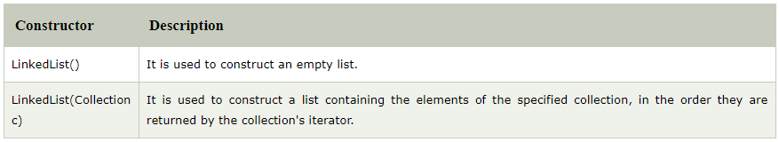
LinkedList class declaration
Let's see the declaration for java.util.LinkedList class.
public class LinkedList<E> extends AbstractSequentialList<E> implements List<E>, Deque<E>, Cloneable, Serializable
Constructors of Java LinkedList
Notes:
Lesson descriptions should be brief.

Slide 24
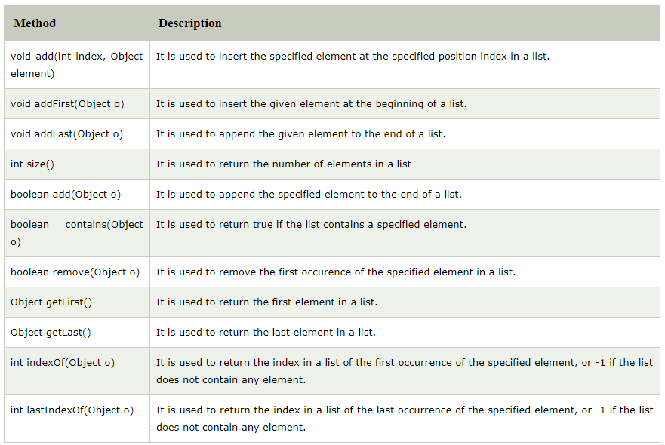
Methods of Java LinkedList
Notes:
Lesson descriptions should be brief.

Slide 25
Java LinkedList Example
import java.util.*;
public class TestCollection7{
public static void main(String args[]){
LinkedList<String> al=new LinkedList<String>();
al.add("Ravi");
al.add("Vijay");
al.add("Ravi");
al.add("Ajay");
Iterator<String> itr=al.iterator();
while(itr.hasNext()){
System.out.println(itr.next());
}
}
}
Notes:
Lesson descriptions should be brief.

Slide 26
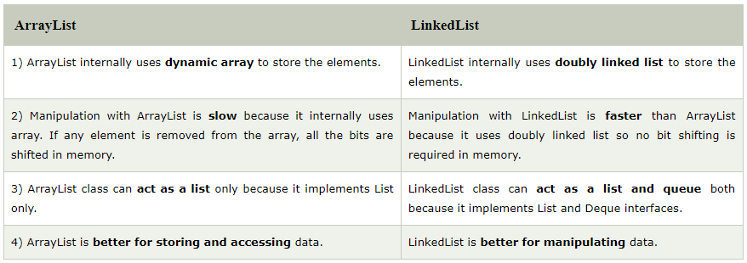
Difference between ArrayList and LinkedList
ArrayList and LinkedList both implements List interface and maintains insertion order. Both are non synchronized classes.
But there are many differences between ArrayList and LinkedList classes that are given below.
Notes:
Lesson descriptions should be brief.

Slide 27
Example of ArrayList and LinkedList in Java
import java.util.*;
class TestArrayLinked{
public static void main(String args[]){
List<String> al=new ArrayList<String>();//creating arraylist
al.add("Ravi");//adding object in arraylist
al.add("Vijay");
al.add("Ravi");
al.add("Ajay");
List<String> al2=new LinkedList<String>();//creating linkedlist
al2.add("James");//adding object in linkedlist
al2.add("Serena");
al2.add("Swati");
al2.add("Junaid");
System.out.println("arraylist: "+al);
System.out.println("linkedlist: "+al2);
}
}
Notes:
Lesson descriptions should be brief.

Slide 28
Searching and Sorting
Notes:
How presentation will benefit audience: Adult learners are more interested in a subject if they know how or why it is important to them.
Presenter’s level of expertise in the subject: Briefly state your credentials in this area, or explain why participants should listen to you.

Slide 29
Searching and Sorting
TWO ARRAY PROCESSING TECHNIQUES that are particularly common are searching and sorting.
Searching here refers to finding an item in the array that meets some specified criterion.
Sorting refers to rearranging all the items in the array into increasing or decreasing order (where the meaning of increasing and decreasing can depend on the context).
An array is not just used to store elements but also access those stored values later on. We may also need to search for a particular element in the array. Sorting the array may also be required at times. We will now look into how these things are done using different algorithms. And we shall also see what the big O notation is and use it to determine the efficiency of these algorithms. .
Notes:
Lesson descriptions should be brief.

Slide 30
Simple Search or Linear Search
The simplest way to search for an element is to iterate through the entire array and compare each value of that array with the target element.
When a match is found, we may break out of the loop if we are sure that there exist no duplicate values.
However, if duplicate values do exist in the array, we might have to continue searching even when a match is found. Since we search for the elements in a linear order from left to right ( by convention, you may also search from the end of the array to the beginning), this algorithm is named as linear search.
Notes:
Lesson descriptions should be brief.

Slide 31
Simple Search or Linear Search
int[] a = { 3, 34, 5,91, 100}; // an array not containing duplicates
int target = 91; // the element to be searched
for( int i=0; i<a.length; i++) {
if(a[i]==target) {
System.out.println ( "Element found at index "+i);
break; // break should be omitted if the array contains duplicates
}
}
Notes:
Lesson descriptions should be brief.

Slide 32
Simple Search or Linear Search
Before we move onto the next algorithm, we will look at what efficiency means in the context of algorithms.
There are two things that have to be taken care of when we write algorithms. The first is the execution time and the second is the memory requirement. Execution time is determined by the numbers of statements that are excited by the algorithm while memory requirement is determined by the additional variables that we use.
In the above program, we have used only one variable, target, which falls under memory requirement. However, the execution time cannot be specified directly as such even if we consider every statement to take the same time to execute.
The reason is that, in this particular algorithm, if the target is in the beginning of the array, then this search would require only a single comparison which is known as the best case.
Notes:
Lesson descriptions should be brief.

Slide 33
Simple Search or Linear Search
However if the target is located at the end of the array, the number of comparisons required would be equal to the length of the array. This is the worst case. The average execution time would occur when the target is located in the middle of the array. So, one thing that we can conclude is that the efficiency of algorithms depends on the input data too. Here arises the need for a standardised comparison of efficiencies. And one solution is the Big O notation.
The big O notation is gives us a relation between the number of data items contained in the array and the number of comparisons required. It takes the worst case into account. It determines how hard an algorithm has to work to obtain the result. In this particular linear search algorithm, if the number of data items are n, then the number of compressions required are also n. This is the order of the algorithm. Hence, linear search is said to be an algorithm of order n.
Notes:
Lesson descriptions should be brief.

Slide 34
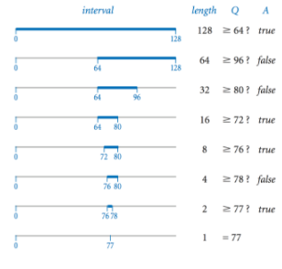
Binary Search
Binary search is an efficient algorithm which can be used to search in a sorted array. Note that the array has to be sorted in either ascending or descending order for the algorithm to worth.
Initially, the range of the array to be searched begins at the first element of the array and extends up to the last element.
This range reduces by half in every iteration. We locate the middle element of the array and compare it with the target. If the target equals the middle element, our search is completed, otherwise the range has to be adjusted accordingly.
Notes:
Lesson descriptions should be brief.

Slide 35
Binary Search
For now, assume that the array is sorted in ascending order. If the middle element is smaller than the target, then the target cannot be found in the left half of the array as each of those elements would also be smaller than the target.
Hence, we can narrow down our search to the right half of the array. On the other hand, if the middle element is larger than the target, we narrow our search to the left auld of the array. Clearly, the range of elements to be searched has been reduced by half.
We now perform the same operation of finding the middle element of the new range and reduce the range accordingly. In the second iteration, the range of elements to be searched reduces to one fourth of the original array length. Similarly, with the third iteration, the range of elements reduce to one eighth.
Notes:
Lesson descriptions should be brief.

Slide 36
Binary Search
We now have to represent this algorithm programmatically. For this purpose, we take two variables left and right which represent the bounds of the array to be searched. Left indicates the left bound of the range and right indicates the right bound of the range.
Initially, the left bound is set to 0 and the right bound is set to array length -1. We then use a while loop to perform the repetitive task of finding the middle element and comparing it with the target event.
We shall look into the termination condition of while shortly. For now, the various things to be included in the while loop are statements to find the middle element, compare it with the target and set the left and right bounds accordingly.
Now coming to the condition in the while loop, this process of finding the middle element and comparing it with the target would end when we are left with just a single element. This happens when the value of left and right becomes identical. On moving further, either right would become less than left or left would become more than right. At this point of time, the search needs to be stopped. Hence the loop condition is left<=right.
Notes:
Lesson descriptions should be brief.

Slide 37
Binary Search
int[] a = {3, 7, 10, 15, 91, 110, 150}; // a sorted array not containing duplicates
int target = 91; // the element to be searched
int left = 0;
int middle;
int right = a.length - 1;
while (left <= right) {
middle = (left + right) / 2;
if (a[middle] == target) {
System.out.println("Element found at index " + middle);
break;
} else if (a[middle] < target) {
left = middle + 1;
} else if (a[middle] > target) {
right = middle - 1;
}
}
Notes:
Lesson descriptions should be brief.

Slide 38
Binary Search
Now we move to sorting of arrays. Sorting refers to arranging the elements of an array in either ascending or descending order. We will in the code snippets that follow arrange the elements in ascending order. The code may be suitably modified to sort in descending order. We will deal with two algorithms: Simple or selection sort and insertion or bubble sort.
The selection sort algorithm is rather quiet simple. We start from the left of the array and search for the smallest element and then place is at index 0 by swapping the two elements. In order to find the smallest element, we first assume that the element at index zero is the smallest and assign the index 0 to a variable, say minPos.
We then compare each of the successive elements with the value held at minPos. If the new value in smaller than what minPos corresponds to, the index stored in minPos is updated. In this way, when we reach the end of the array, the variable minPos will be holding the index of the smallest element. Now, we exchange the number stored at index 0 with the number stored at index minPos.
Notes:
Lesson descriptions should be brief.

Slide 39
Binary Search
To do this, we require an additional variable and a simple pair of statements shown below do not work. a[0] =a[minPos]; a[minPos]=a[0];
After the above two statements are executed, what we will be left with is just a single value which was earlier the value stored at the index minPos. The value at index 0 is lost. To avoid this, the value at index 0 should first be stored in a temporary variable and swapping be performed using the following set of three statements.
int temp = a[0]; a[0] = a[minPos]; a[minPos]= temp;
Notes:
Lesson descriptions should be brief.

Slide 40
Binary Search
After this first iteration, we bought the smallest element to index 0. Now, we need to search for the second smallest element. To do it, we assume that the element at index 1 is the smallest and proceed as before. In this way, we sort the entire array. Given below is the example for selection sort.
int[] a = {4, 85, 7, 1, 0, 36, -5, 48}; int minPos; for (int i = 0; i < a.length; i++) { minPos = i; for (int j = i + 1; j < a.length; j++) { if (a[j] < a[minPos]) { minPos = j; } } int temp = a[i]; a[i] = a[minPos]; a[minPos] = temp; }
Notes:
Lesson descriptions should be brief.

Slide 41
Binary Search
Note that the above code uses two for loop, one nested within the other. The outer loop keeps track of the position from which the elements are to be searched for the smallest data item. Initially, this position is 0.
After we bring the smallest item to index 0, this position in the second iteration becomes 1. The inner loop is used to find the smallest elements starting from the position defined by the outer loop. After finding the smallest element, the two values are swapped.
This algorithm has an order of n2. The outer loop executes for n times. And the inner loop executes for variable number of times deepening on the value of i. When i is 0, the inner lope executes n-1 times. When i is 1, the inner loops excites n-2 times and so on. Therefore the total number of comparisons made come out to be (n-1)+(n-2)+(n-3)+....(n-(n-1)) which equals (n-1)*n-(1+2+3....n-1).
Notes:
Lesson descriptions should be brief.

Slide 42
Bubble Sort
The last of the algorithms that we are gaining to deal with is the bubble sort method. This algorithm has its name derived from the water bubbles which surface to the top. In a similar way, in this algorithm, we make larger numbers move to the top of the array when we wish to sort in ascending order.
We iterate through the array from the left to the right and compare each pair of successive values in turn. If they are in the right order, we leave them as they are. However, if a larger item is on the left of a smaller item, we swap them. Note that only successive values are compared. In this way, when we move to the rightmost end of the array, the largest value is guaranteed to have been bubbled to the top of the array.
Notes:
Lesson descriptions should be brief.

Slide 43
Bubble Sort
For example, if the largest element was at index 0 initially, then in each step of comparison, this element is moved up ultimately bringing it to the top. In this way when we repeat this process for n-1 times, the entire array is guaranteed to be sorted.
We can further improve this algorithm by setting proper loop termination conditions. This algorithm requires two nested loops. Within the inner loop, the loop condition can be stated to be a relation with the outer counter variable rather than the end of the array.
For example, if it is the fifth iteration, then the four largest elements have already been bubbled to the top of the array. So, there is no need of comparing those values gain. So, the loop condition can be specified as j<x.length-1-i. Given below is the code for bubble sort.
Notes:
Lesson descriptions should be brief.

Slide 44
Bubble Sort
int[] a = {4, 85, 7, 1, 0, 36, -5, 48};
for (int i = 0; i < a.length - 1; i++) {
for (int j = 0; j < a.length - 1 - I; j++) {
if (a[j + 1] < a[j]) {
int temp = a[j];
a[j] = a[j + 1];
a[j + 1] = temp;
}
}
}
The bubble sort algorithm also has an order of n2.
Notes:
Lesson descriptions should be brief.

Slide 45
I/O
Notes:
How presentation will benefit audience: Adult learners are more interested in a subject if they know how or why it is important to them.
Presenter’s level of expertise in the subject: Briefly state your credentials in this area, or explain why participants should listen to you.

Slide 46
Java I/O
Java I/O (Input and Output) is used to process the input and produce the output.
Java uses the concept of stream to make I/O operation fast. The java.io package contains all the classes required for input and output operations.
We can perform file handling in java by Java I/O API.
Notes:
Lesson descriptions should be brief.

Slide 47
Stream
A stream is a sequence of data.In Java a stream is composed of bytes. It's called a stream because it is like a stream of water that continues to flow.
In java, 3 streams are created for us automatically. All these streams are attached with console.
System.out: standard output stream
System.in: standard input stream
System.err: standard error stream
Notes:
Lesson descriptions should be brief.

Slide 48
Stream
Let's see the code to print output and error message to the console.
System.out.println("simple message");
System.err.println("error message");
Let's see the code to get input from console.
int i=System.in.read();//returns ASCII code of 1st character
System.out.println((char)i);//will print the character
Notes:
Lesson descriptions should be brief.

Slide 49
OutputStream vs InputStream
OutputStream
Java application uses an output stream to write data to a destination, it may be a file, an array, peripheral device or socket.
InputStream
Java application uses an input stream to read data from a source, it may be a file, an array, peripheral device or socket.
Notes:
Lesson descriptions should be brief.

Slide 50
OutputStream vs InputStream
Notes:
Lesson descriptions should be brief.

Slide 51
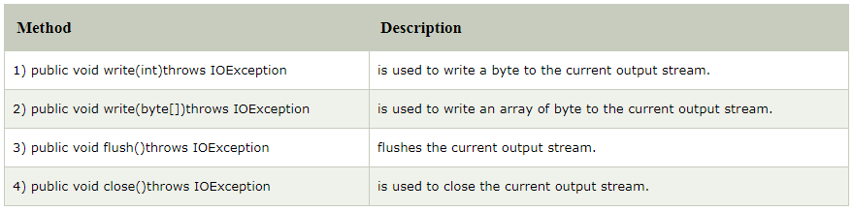
OutputStream class
OutputStream class is an abstract class. It is the super class of all classes representing an output stream of bytes. An output stream accepts output bytes and sends them to some sink.
Notes:
Lesson descriptions should be brief.

Slide 52
OutputStream Hierarchy
Notes:
Lesson descriptions should be brief.

Slide 53
FileOutputStream Class
Java FileOutputStream is an output stream used for writing data to a file.
If you have to write primitive values into a file, use FileOutputStream class.
You can write byte-oriented as well as character-oriented data through FileOutputStream class.
But, for character-oriented data, it is preferred to use FileWriter than FileOutStream.
public class FileOutputStream extends OutputStream
Notes:
Lesson descriptions should be brief.

Slide 54
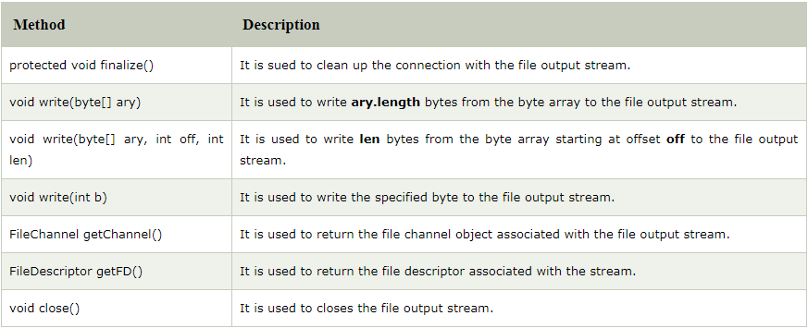
FileOutputStream methods
Notes:
Lesson descriptions should be brief.

Slide 55
Example 1: write byte
import java.io.FileOutputStream;
public class FileOutputStreamExample {
public static void main(String args[]){
try{
FileOutputStream fout=new FileOutputStream("D:\\testout.txt");
fout.write(65);
fout.close();
System.out.println("success...");
}catch(Exception e){System.out.println(e);}
}
}
Notes:
Lesson descriptions should be brief.

Slide 56
Example 1: write byte
Output:
Success...
The content of a text file testout.txt is set with the data A.
testout.txt
A
Notes:
Lesson descriptions should be brief.

Slide 57
Example 2: write string
import java.io.FileOutputStream;
public class FileOutputStreamExample {
public static void main(String args[]){
try{
FileOutputStream fout=new FileOutputStream("D:\\testout.txt");
String s="Welcome to DANA.";
byte b[]=s.getBytes();//converting string into byte array
fout.write(b);
fout.close();
System.out.println("success...");
}catch(Exception e){System.out.println(e);}
}
}
Notes:
Lesson descriptions should be brief.

Slide 58
Example 2: write string
Output:
Success...
The content of a text file testout.txt is set with the data Welcome to DANA.
testout.txt
Welcome to DANA.
Notes:
Lesson descriptions should be brief.

Slide 59
FileInputStream Class
Java FileInputStream class obtains input bytes from a file.
It is used for reading byte-oriented data (streams of raw bytes) such as image data, audio, video etc.
You can also read character-stream data. But, for reading streams of characters, it is recommended to use FileReader class.
public class FileInputStream extends InputStream
Notes:
Lesson descriptions should be brief.

Slide 60
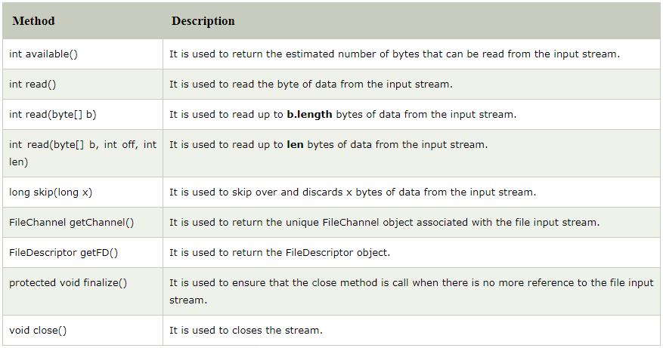
FileInputStream methods
Notes:
Lesson descriptions should be brief.

Slide 61
Example 1: read single character
Before running the code, a text file named as "testout.txt" is required to be created. In this file, we are having following content:
“Welcome to DANA”.
import java.io.FileInputStream;
public class DataStreamExample {
public static void main(String args[]){
try{
FileInputStream fin=new FileInputStream("D:\\testout.txt");
int i=fin.read();
System.out.print((char)i);
fin.close();
}catch(Exception e){System.out.println(e);}
}
}
Notes:
Lesson descriptions should be brief.

Slide 62
Example 1: read single character
After executing the above program, you will get a single character from the file which is 87 (in byte form). To see the text, you need to convert it into character.
Output:
W
Notes:
Lesson descriptions should be brief.

Slide 63
Example 2: read all characters
import java.io.FileInputStream;
public class DataStreamExample {
public static void main(String args[]){
try{
FileInputStream fin=new FileInputStream("D:\\testout.txt");
int i=0;
while((i=fin.read())!=-1){
System.out.print((char)i);
}
fin.close();
}catch(Exception e){System.out.println(e);}
}
}
Output:
Welcome to DANA
Notes:
Lesson descriptions should be brief.

Slide 64
BufferedOutputStream Class
Java BufferedOutputStream class is used for buffering an output stream.
It internally uses buffer to store data.
It adds more efficiency than to write data directly into a stream and makes the performance fast.
For adding the buffer in an OutputStream, use the BufferedOutputStream class. Let's see the syntax for adding the buffer in an OutputStream:
OutputStream os =
new BufferedOutputStream(new FileOutputStream("D:\\IO Package\\testout.txt"));
public class BufferedOutputStream extends FilterOutputStream
Notes:
Lesson descriptions should be brief.

Slide 65
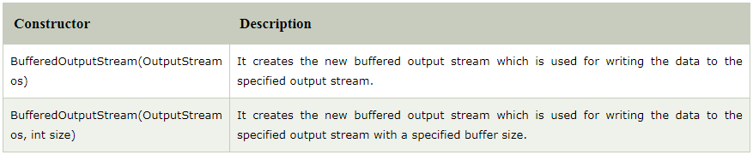
BufferedOutputStream constructors
Notes:
Lesson descriptions should be brief.

Slide 66
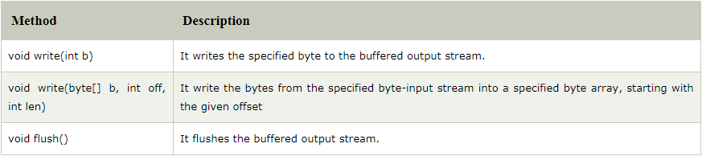
BufferedOutputStream methods
Notes:
Lesson descriptions should be brief.

Slide 67
Example of BufferedOutputStream
In this example, we are writing the textual information in the BufferedOutputStream object which is connected to the FileOutputStream object. The flush() flushes the data of one stream and send it into another. It is required if you have connected the one stream with another.
import java.io.*;
public class BufferedOutputStreamExample{
public static void main(String args[])throws Exception{
FileOutputStream fout=new FileOutputStream("D:\\testout.txt");
BufferedOutputStream bout=new BufferedOutputStream(fout);
String s="Welcome to DANA.";
byte b[]=s.getBytes();
bout.write(b);
bout.flush();
bout.close();
fout.close();
System.out.println("success");
}
}
Notes:
Lesson descriptions should be brief.

Slide 68
Example of BufferedOutputStream
Output:
Success
testout.txt
Welcome to DANA
Notes:
Lesson descriptions should be brief.

Slide 69
BufferedInputStream Class
BufferedInputStream class is used to read information from stream.
It internally uses buffer mechanism to make the performance fast.
When the bytes from the stream are skipped or read, the internal buffer automatically refilled from the contained input stream, many bytes at a time.
When a BufferedInputStream is created, an internal buffer array is created
public class BufferedInputStream extends FilterInputStream
Notes:
Lesson descriptions should be brief.

Slide 70
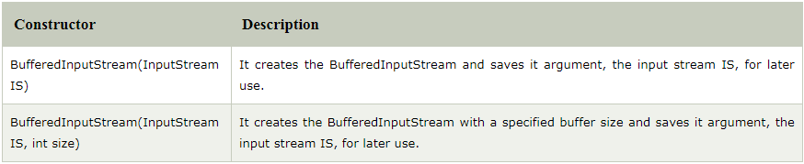
BufferedInputStream constructors
Notes:
Lesson descriptions should be brief.

Slide 71
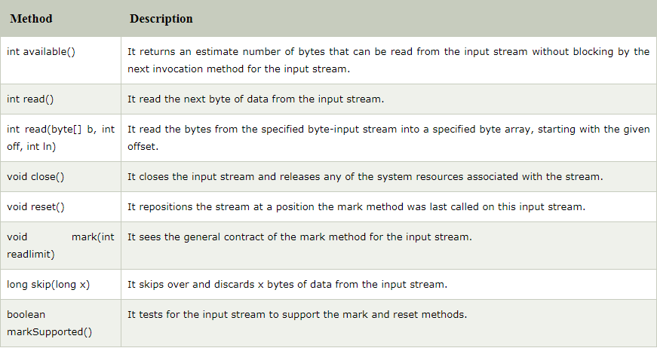
BufferedInputStream methods
Notes:
Lesson descriptions should be brief.

Slide 72
Example of BufferedInputStream
import java.io.*;
public class BufferedInputStreamExample{
public static void main(String args[]){
try{
FileInputStream fin=new FileInputStream("D:\\testout.txt");
BufferedInputStream bin=new BufferedInputStream(fin);
int i;
while((i=bin.read())!=-1){
System.out.print((char)i);
}
bin.close();
fin.close();
}catch(Exception e){System.out.println(e);}
}
}
Notes:
Lesson descriptions should be brief.

Slide 73
Example of BufferedOutputStream
Here, we are assuming that you have following data in "testout.txt" file:
DANA
Output:
DANA
Notes:
Lesson descriptions should be brief.

Slide 74
FilePermission Class
Java FilePermission class contains the permission related to a directory or file. All the permissions are related with path. The path can be of two types:
D:\\IO\\-: It indicates that the permission is associated with all sub directories and files recursively.
D:\\IO\\*: It indicates that the permission is associated with all directory and files within this directory excluding sub directories.
public final class FilePermission extends Permission implements Serializable
Notes:
Lesson descriptions should be brief.

Slide 75
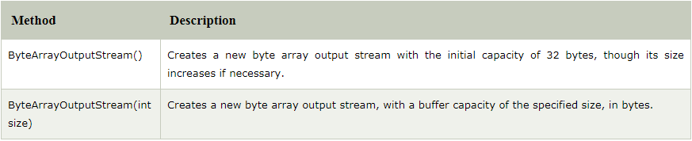
FilePermission constructors
Notes:
Lesson descriptions should be brief.

Slide 76
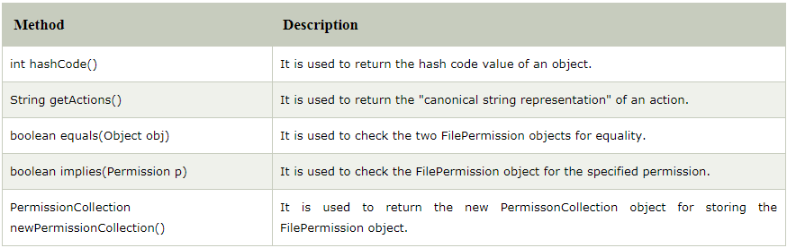
FilePermission methods
Notes:
Lesson descriptions should be brief.

Slide 77
Example of FilePermission
Let's see the simple example in which permission of a directory path is granted with read permission and a file of this directory is granted for write permission
import java.io.*;
import java.security.PermissionCollection;
public class FilePermissionExample{
public static void main(String[] args) throws IOException {
String srg = "D:\\IO Package\\java.txt";
FilePermission file1 = new FilePermission("D:\\IO Package\\-", "read");
PermissionCollection permission = file1.newPermissionCollection();
permission.add(file1);
FilePermission file2 = new FilePermission(srg, "write");
permission.add(file2);
if(permission.implies(new FilePermission(srg, "read,write"))) {
System.out.println("Read, Write permission is granted for the path "+srg );
}else {
System.out.println("No Read, Write permission is granted for the path "+srg); }
}
}
Notes:
Lesson descriptions should be brief.

Slide 78
Example of FilePermission
Output:
Read, Write permission is granted for the path D:\IO Package\java.txt
Notes:
Lesson descriptions should be brief.

Slide 79
FileWriter Class
Java FileWriter class is used to write character-oriented data to a file. It is character-oriented class which is used for file handling in java.
Unlike FileOutputStream class, you don't need to convert string into byte array because it provides method to write string directly.
public class FileWriter extends OutputStreamWriter
Notes:
Lesson descriptions should be brief.

Slide 80
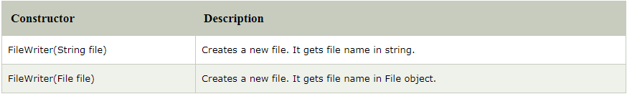
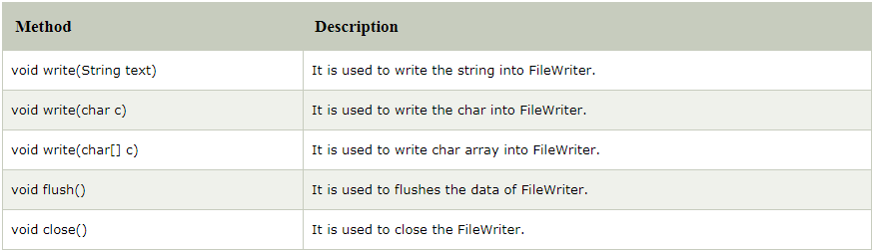
FileWriter constructors
FileWriter methods
Notes:
Lesson descriptions should be brief.

Slide 81
Example of FileWriter
In this example, we are writing the data in the file testout.txt using Java FileWriter class.
import java.io.FileWriter;
public class FileWriterExample {
public static void main(String args[]){
try{
FileWriter fw=new FileWriter("D:\\testout.txt");
fw.write("Welcome to DANA");
fw.close();
}catch(Exception e){System.out.println(e);}
System.out.println("Success...");
}
}
Notes:
Lesson descriptions should be brief.

Slide 82
Example of FileWriter
Output:
Success...
testout.txt:
Welcome to DANA
Notes:
Lesson descriptions should be brief.

Slide 83
FileReader Class
Java FileReader class is used to read data from the file. It returns data in byte format like FileInputStream class.
It is character-oriented class which is used for file handling in java.
public class FileReader extends InputStreamReader
Notes:
Lesson descriptions should be brief.

Slide 84
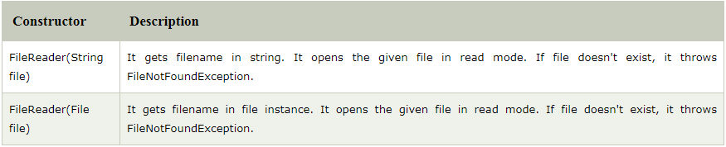
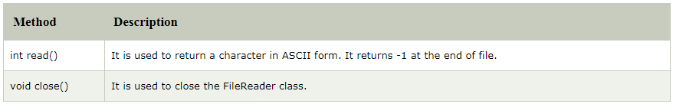
FileReader constructors
FileReader methods
Notes:
Lesson descriptions should be brief.

Slide 85
Example of FileReader
In this example, we are reading the data from the text file testout.txt using Java FileReader class.
import java.io.FileReader;
public class FileReaderExample {
public static void main(String args[])throws Exception{
FileReader fr=new FileReader("D:\\testout.txt");
int i;
while((i=fr.read())!=-1)
System.out.print((char)i);
fr.close();
}
}
Notes:
Lesson descriptions should be brief.

Slide 86
Example of FileReader
Here, we are assuming that you have following data in "testout.txt" file:
Welcome to DANA
Output:
Welcome to DANA
Notes:
Lesson descriptions should be brief.

Slide 87
BufferedWriter Class
Java BufferedWriter class is used to provide buffering for Writer instances. It makes the performance fast. It inherits Writer class.
The buffering characters are used for providing the efficient writing of single arrays, characters, and strings.
public class BufferedWriter extends Writer
Notes:
Lesson descriptions should be brief.

Slide 88
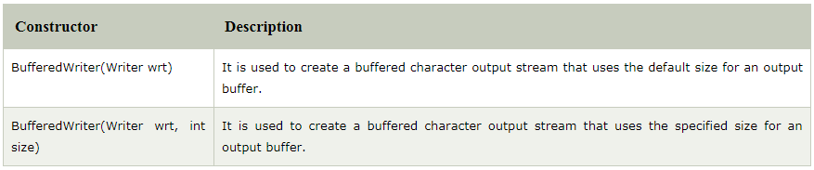
BufferedWriter constructors
Notes:
Lesson descriptions should be brief.

Slide 89
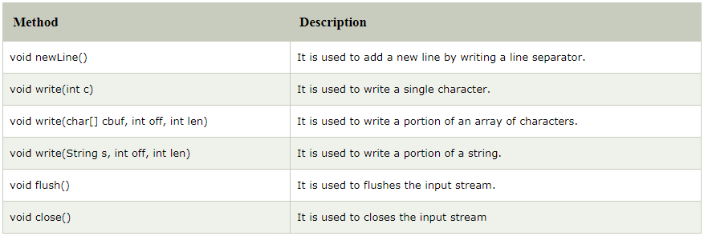
BufferedWriter methods
Notes:
Lesson descriptions should be brief.

Slide 90
Example of BufferedWriter
Let's see the simple example of writing the data to a text file testout.txt using Java BufferedWriter.
import java.io.*;
public class BufferedWriterExample {
public static void main(String[] args) throws Exception {
FileWriter writer = new FileWriter("D:\\testout.txt");
BufferedWriter buffer = new BufferedWriter(writer);
buffer.write("Welcome to DANA");
buffer.close();
System.out.println("Success");
}
}
Notes:
Lesson descriptions should be brief.

Slide 91
Example of BufferedWriter
Output:
success
testout.txt:
Welcome to DANA
Notes:
Lesson descriptions should be brief.

Slide 92
BufferedReader Class
Java BufferedReader class is used to read the text from a character-based input stream.
It can be used to read data line by line by readLine() method.
It makes the performance fast & inherits Reader class.
public class BufferedReader extends Reader
Notes:
Lesson descriptions should be brief.

Slide 93
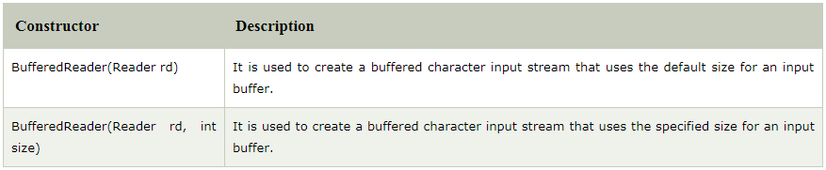
BufferedReader constructors
Notes:
Lesson descriptions should be brief.

Slide 94
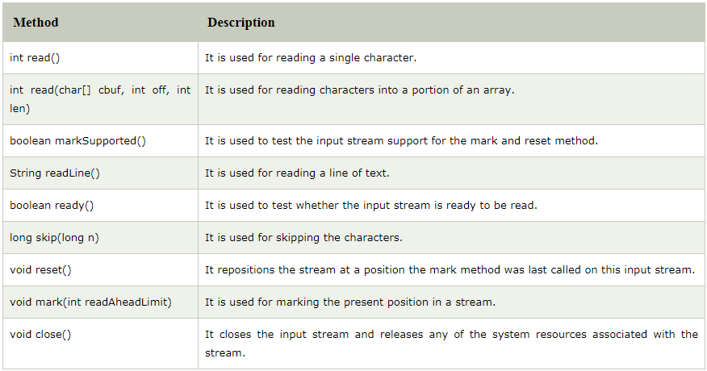
BufferedReader methods
Notes:
Lesson descriptions should be brief.

Slide 95
Example of BufferedReader
In this example, we are reading the data from the text file testout.txt using Java BufferedReader class.
import java.io.*;
public class BufferedReaderExample {
public static void main(String args[])throws Exception{
FileReader fr=new FileReader("D:\\testout.txt");
BufferedReader br=new BufferedReader(fr);
int i;
while((i=br.read())!=-1){
System.out.print((char)i);
}
br.close();
fr.close();
}
}
Notes:
Lesson descriptions should be brief.

Slide 96
Example of BufferedWriter
Here, we are assuming that you have following data in "testout.txt" file:
Welcome to DANA
Output:
Welcome to DANA
Notes:
Lesson descriptions should be brief.

Slide 97
Reading data from console by InputStreamReader and BufferedReader
In this example, we are connecting the BufferedReader stream with the InputStreamReader stream for reading the line by line data from the keyboard.
import java.io.*;
public class BufferedReaderExample{
public static void main(String args[])throws Exception{
InputStreamReader r=new InputStreamReader(System.in);
BufferedReader br=new BufferedReader(r);
System.out.println("Enter your name");
String name=br.readLine();
System.out.println("Welcome "+name);
}
}
Notes:
Lesson descriptions should be brief.

Slide 98
Reading data from console by InputStreamReader and BufferedReader
Output:
Enter your name
Nakul Jain
Welcome Nakul Jain
Notes:
Lesson descriptions should be brief.

Slide 99
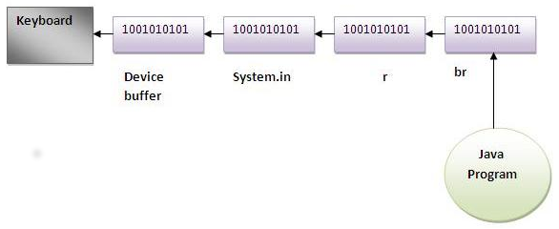
Reading data from console by InputStreamReader and BufferedReader
Notes:
Lesson descriptions should be brief.

Slide 100
Another example of reading data from console until user writes stop
In this example, we are reading and printing the data until the user prints stop.
import java.io.*;
public class BufferedReaderExample{
public static void main(String args[])throws Exception{
InputStreamReader r=new InputStreamReader(System.in);
BufferedReader br=new BufferedReader(r);
String name="";
while(!name.equals("stop")){
System.out.println("Enter data: ");
name=br.readLine();
System.out.println("data is: "+name);
}
br.close();
r.close();
}
}
Notes:
Lesson descriptions should be brief.

Slide 101
Another example of reading data from console until user writes stop
Output:
Enter data: Nakul
data is: Nakul
Enter data: 12
data is: 12
Enter data: stop
data is: stop
Notes:
Lesson descriptions should be brief.

Slide 102


